Slide 1
Fresno Assessment of Student Teachers (FAST)
Teaching Sample Project (TSP)
Jeanie Behrend, FAST Coordinator

Slide 2
FAST: Two Performance Tasks
Site Visitation Project
formal observation of teaching
Teaching Sample Project
written unit of study with focus on assessment
Both tasks must be completed for the Multiple Subject
and Single Subject credentials.

Slide 3
Teaching Sample Project
integrated unit of study with focus on
(a) content knowledge and literacy
(b) assessment
This task is completed in final student teaching.

Slide 4
Teaching Sample Project (TSP)
Multiple Subject Program
TSP demonstrates the ability to plan, implement, analyze and improve the effectiveness of instruction based on student learning.
For Multiple Subject candidates the unit must have a focus on English Language Arts (CCSS-ELA) and at least one other content area.
  At least 5 cohesive lessons in unit
Completed in EHD 170/160B – Final Student Teaching
DUE: Tuesday, December 1
Scored: December 4-11 by faculty and coaches

Slide 5
Teaching Sample Project (TSP)
Single Subject Program
TSP demonstrates the ability to plan, implement, analyze and improve the effectiveness of instruction based on student learning.
For Single Subject candidates the unit must have a focus on their credential content area with integrated English Language Arts (CCSS-ELA/Literacy standards) and/or English Language Development (ELD standards).
  At least 5 cohesive lessons in unit
Completed in EHD 155B – Final Student Teaching
DUE date: determined by each discipline area
Scored by coaches

Slide 6
Teaching Sample Project (TSP) unit of study, with focus on assessment
Do I have to teach the whole class?
Typically, the unit must be designed and taught to the whole class. In this virtual environment, you may design and teach the unit to a portion of the class or to the whole class.
Do I have to assess the whole class?
You need to assess the students who participate in the unit. If that’s the whole class, then you need to assess the whole class. If that’s a portion of the class, you need to assess that portion of the class.
How can the lessons in the unit (at least 5) be delivered?
In this era of virtual instruction, the 5 lessons can include a combination of synchronous and asynchronous lessons. At least some lessons MUST be synchronous because you have to address how you adapt instruction based on monitoring students during a lesson.

Slide 7
Parts of the Teaching Sample Project
See page 18 in TSP manual
Before Teaching the Unit
Students in Context
Learning Outcomes
Assessment Plan
Design for Instruction
After Teaching the Unit
Instructional Decision Making
Analysis of Student Learning
Reflection and Self-Evaluation

Slide 8
Students in Context, pp. 20-21
What do I know about my students that will help me plan?
How will I manage behavior and routines to enhance learning?

Slide 9
Format of each section
Heading of section
General Teaching Standard and TPEs

Slide 10
General Description of this Section

Slide 11
Key Elements of this Section
--you need to include!!
Use as HEADINGS in your document

Slide 12
Key Elements of this Section
--you need to include!!
Use as HEADINGS in your document

Slide 13
Checklist of what should be included

Slide 14
Students in Context
Collect school and classroom data
  Students in Context form, p. 32 in FAST manual
  NOTE: Include information on the whole class, even if you are only teaching a portion of the class.
Implications for instruction for students with:
  Different levels of English proficiency
  Identified special needs
  Other instructional needs
Classroom management plan
  [see next page]

Slide 15
Students in Context
Classroom management plan
  expectations and consequences for:
    students taking responsibility
    instances of intolerance
    other
  classroom routines
    two examples
    describe how established and maintained
NOTE: You may address classroom expectations and routines for either in person instruction (what you would do), virtual instruction, or a combination of both.

Slide 16
Students in Context
  Review the scoring rubric on page 33.

Slide 17

Learning Outcomes, pp. 22-23
What should I teach? How is it
relevant to my students?

Slide 18
Learning Outcomes
Description of integrated unit
  addresses literacy and content knowledge
  ”big picture” ideas in unit
Learning outcomes related to standards
  3 to 5 learning outcomes
  Content standards from 2 or more disciplines, one must be English Language Arts (ELA)
Rationale of appropriateness for students

Slide 19
Outcome 1
ELA & Science
Outcome 2
ELA
Outcome 3
ELA & Science
Lesson 1
Lesson 2
Lesson 3
Lesson 4
Lesson 5
Each unit outcome should be addressed in one or more lessons.
Each lesson may address one or more outcomes.

Slide 20
Learning Outcomes
  Review the scoring rubric on page 34.

Slide 21
Assessment Plan, pp. 24-26
How will I know what and whether my students are learning?

Slide 22
Assessment Plan
Planning part:
Select, adapt, or develop assessments to assist in:
  planning (pre-assessments),
  monitoring student progress (formative assessments),
  measuring student learning (summative assessments)

Slide 23
Assessment Plan
Written part:
For 2 learning outcomes, descriptions of
  pre- and summative assessments
  scoring criteria
Descriptions of 2 specific formative assessments
Respond to questions to justify your choice of format and assessment items

Slide 24
How will you know what students learned?
REMEMBER: Include copy of assessments
Give specific examples
related to your unit.

Slide 25
Assessment Plan
  Review the scoring rubric on page 35.

Slide 26
Design for Instruction, pp. 27-28
How will I design cohesive lessons that are relevant and
engaging to all students AND support the content?

Slide 27
Design for Instruction
Summary of pre-assessment data
Unit summary and overview – a minimum of 5 cohesive lessons in your UNIT
  NOTE: You must teach all the lessons in your unit!!!
Three lesson plans, written by you – using a lesson plan format of your choosing - submitted for TSP
Description and rationale for:
  ACCESS to CONTENT
  ENGLISH LANGUAGE DEVELOPMENT AND LITERACY SKILLS
  TECHNOLOGY

Slide 28
Design for Instruction
  Review the scoring rubric on page 36.

Slide 29
Instructional Decision-Making, p. 29
How will I monitor students during lessons and
adjust instruction based on their learning?

Slide 30
Instructional Decision-Making
Instructional Decision A & Instructional Decision B
Techniques for monitoring student learning
Adjustments made to instruction based on student learning
Why did your adjustment improve students’ progress toward the learning outcome? Evidence?

Slide 31
Instructional Decision Making
  Review the scoring rubric on page 37.

Slide 32
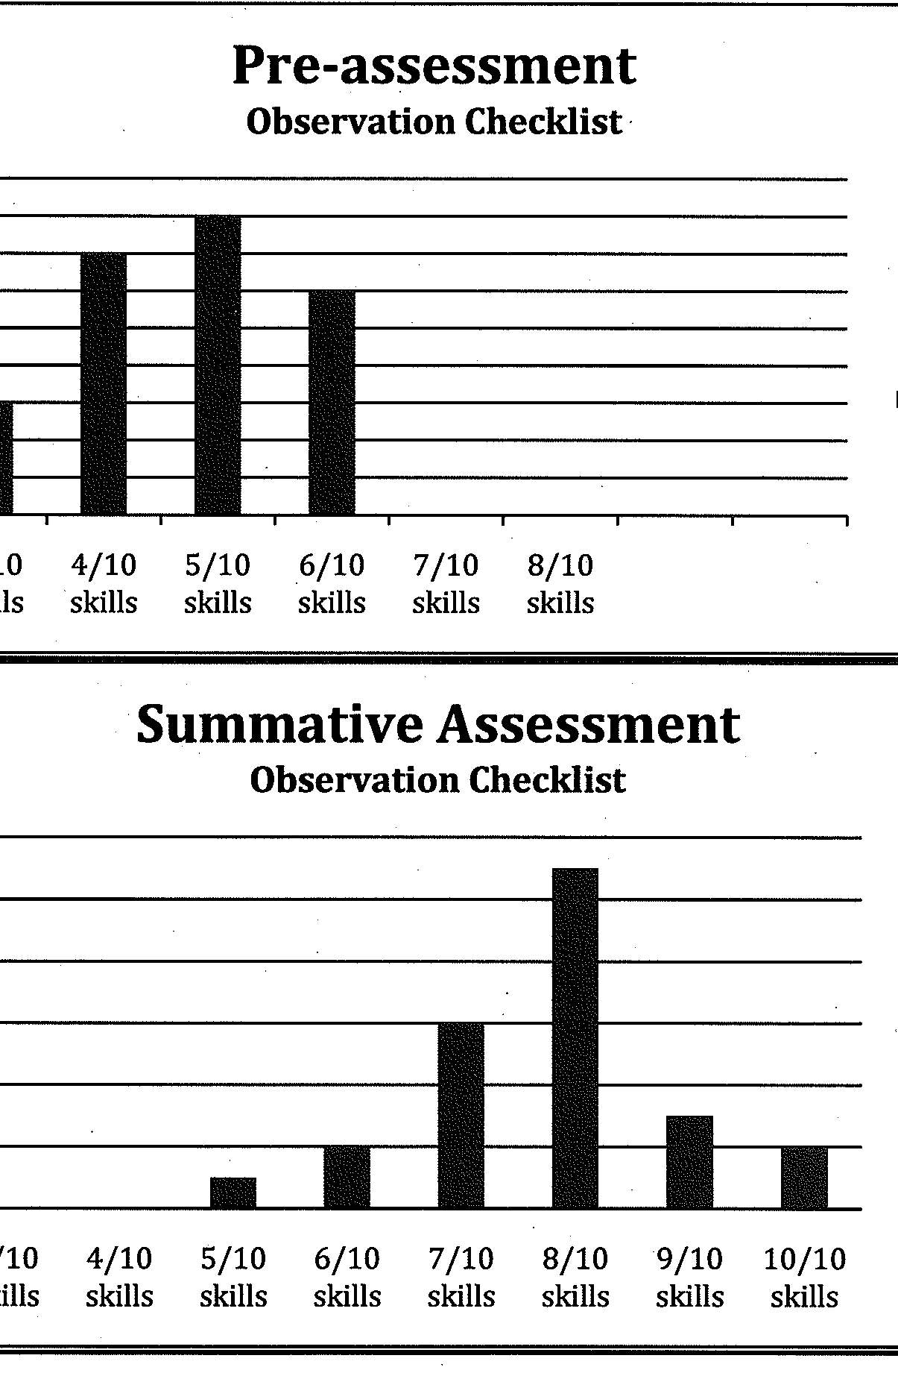
Analysis of Student Learning, p. 30
Did my students learn the content
of the unit? What is the evidence?

Slide 33
Analysis of Student Learning
Class Analysis
  Results of assessments - DATA
  Analysis and conclusions of student learning related to unit learning outcomes
Progress report (for one student who struggled during the unit)
  Analysis of learning with supporting data
  Suggestions – support provided by teacher, school, and/or parents

Slide 34
Analysis of Student Learning
  Review the scoring rubric on page 38.

Slide 35
Reflection and Self-Evaluation, p.31
How effective was the unit? What would I change?

Slide 36
Reflection and Self-Evaluation
Reflect on your performance as a teacher:
  effective instructional strategies for ALL learners: BE SPECIFIC ABOUT THE GROUPS OF STUDENTS WHO BENEFIT FROM PARTICULAR STRATEGIES. [Think about what you wrote in the Students in Context section.]
  alignment and effectiveness of assessments
  influence of subject-matter knowledge
Suggested changes to the unit
Professional goal related to the unit, with next steps

Slide 37
Reflection and Self-Evaluation
  Review the scoring rubric on page 39.

Slide 38
Feedback on Teaching Sample Project
Unacceptable forms of support: Editing and providing specific feedback on the unit by the University Coach, Mentor or colleague.
Make the unit and lessons your own: Some units may be planned with school colleagues; however, you need to put your own stamp on the elements of the unit and the written lesson plans.
You must teach all the lessons you identify in the unit—a minimum of 5 cohesive lessons. There may be a combination of synchronous and asynchronous lessons in your unit.
You must write all portions of the TSP yourself.

Slide 39
Teaching Sample Project
Submission Information
Submitted on Tk20.
Passing Score: 2 or better on each of the 7 sections.
Score of 1 on any section: That section must be revised and scored again.
Remember to include Section Headings and headings within each section
Anonymity for school, teachers, and students.
.

Slide 40
Things to Remember: Writing
CLARITY: Be clear and concise. Saying more isn’t better. Target your responses to the prompt and rubric.
SPECIFICITY: General statements don’t show your knowledge. Be specific and give examples to support your statements.

Slide 41
RECOMMENDATIONS
Start early.
Keep records of what you do.
Collect student work.
Keep it manageable.
REMEMBER: If you do not earn at least a 2 on each section, you will need to redo the section and have it scored again.

Slide 42
Read the directions carefully.
Review the rubrics as you write, with a focus on level 3.
This is an opportunity to show what you know and highlight the range of your teaching techniques.

